Slide 1
Open Source Software and Digital Sovereignity in Asia: Lessons for Germany
Mamad Farrahi
Notes:
Hi and welcome to my presentation
I’m Mamad Farrahi studying eXtended AI at uni Würzburg
Today I’m gonna present you open-source approaches and digital soverinity in Asian countries and lessons for Germany
The aim is to zoom our POV on Asian country to see how they took advantage of open-source approaches and how it helped individuals and the society as a whole.

Slide 2
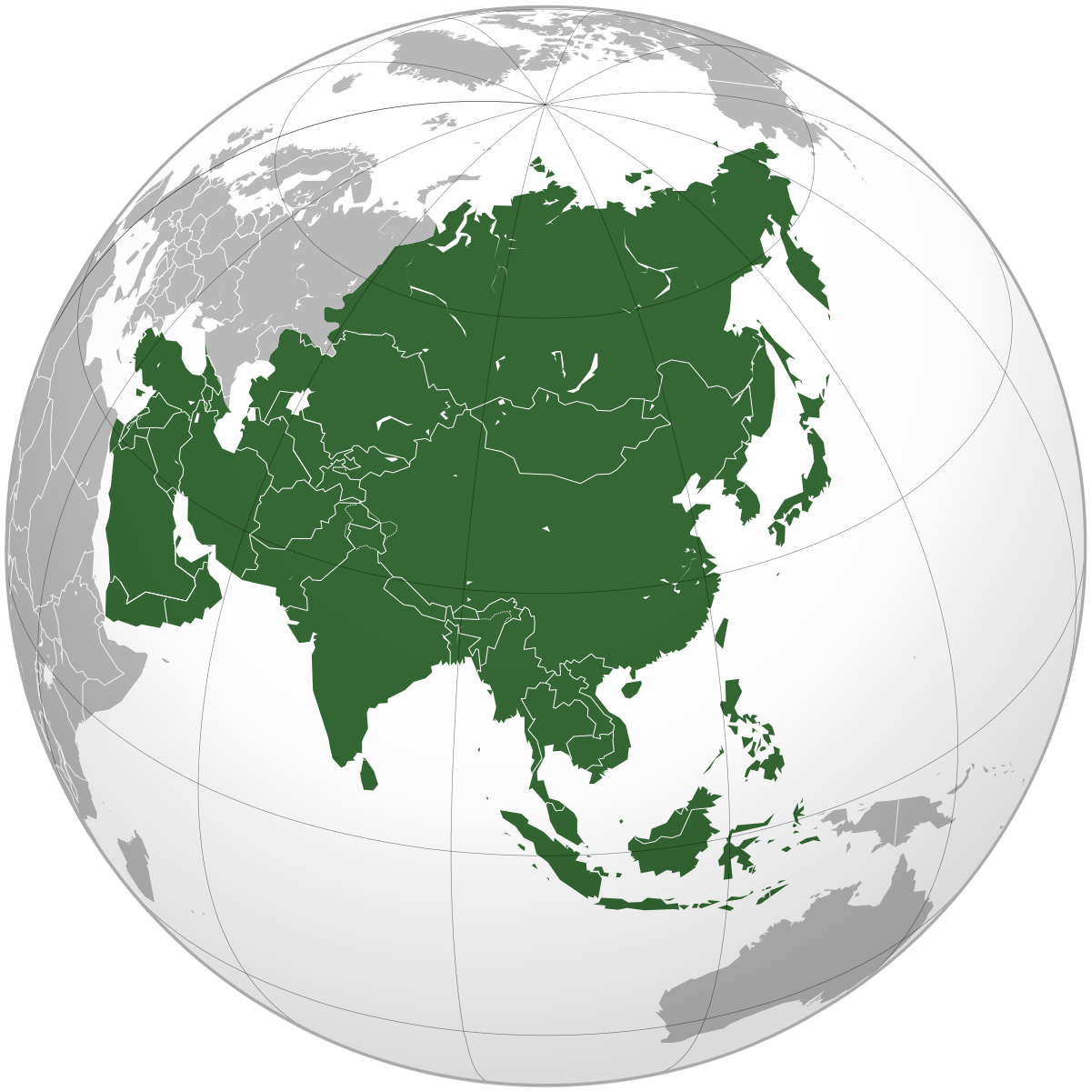
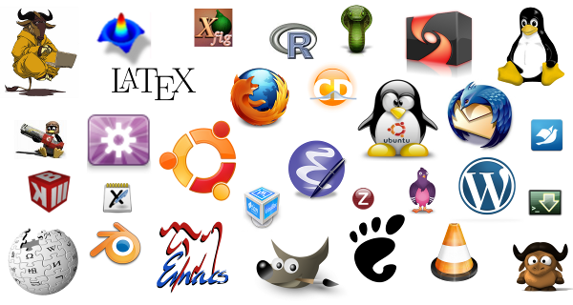

Introduction
What is Open Source Software?
What are benefits?
Notes:
* Let's start with the basics: open-source software is software with publicly accessible source code. This means anyone can view, use, modify, and distribute it.
* Open-source software comes with many advantages: cost savings, customization, collaboration, transparency, security, and innovation. Let's briefly touch on each of these.

Slide 3


Benfits
Cost
Customization
Notes:
Open-source software is often free or low-cost. This allows organizations to save on licensing fees, support costs, and other expenses usually associated with proprietary software.
Open-source software is typically customizable, allowing users to modify the software to suit their specific needs.

Slide 4


Benfits
Collaboration
Transparency
Notes:
Open-source software encourages global collaboration, allowing developers from around the world to contribute to projects, share expertise, and learn from one another.
Transparency is a significant benefit. The publicly accessible code can be scrutinized, ensuring it's secure, reliable, and free from hidden vulnerabilities.

Slide 5


Benefits
Security
Innovation
Notes:
Thanks to its transparent nature and large developer community, open-source software is often considered more secure than proprietary software.
Finally, open-source software fosters innovation, enabling developers to experiment with new ideas, create novel applications, and build upon existing solutions.

Slide 6


Successful Open Source Examples
Telegram
Linux
Notes:
Telegram is a widely recognized open-source messaging platform. Its stability, adaptability, and constant innovation contribute to its success.
Linux, created by Linus Torvalds, has had a major impact on technology. Its influence spans various industries, from the global smartphone industry with Android to healthcare devices and the mobility industry.

Slide 7
Structure
Open-data and benefits in Governmental Level in Japan 🇯🇵
Car Industry and Economical Level in China 🇨🇳
Cultural advantages in Iran 🇮🇷
Digital Sovereignty in India 🇮🇳
Notes:
Japan has used open data to influence the government and policy
How open-source Apollo fastly helped China to grow in car industry
By looking at Vazirmatn font, we see how open-source can help al
examine India’s actions towards achieving digital sovereignty, homegrown solutions and robust data management.

Slide 8

Policy and Governmental Level in Japan
Notes:
This country is committed to open data, bringing significant benefits to the nation and its citizens.
Accessible governmental data discourages corruption, and fosters trust between the government and its citizens.
Let's explore some examples from Japan's e-Gov data portal that demonstrate the positive impact of open data on the country and its people.

Slide 9
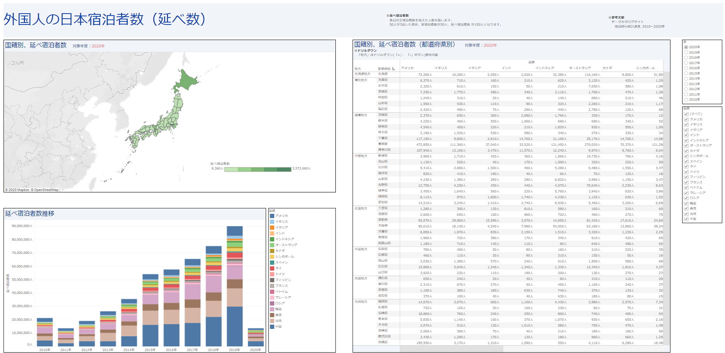
Overnight Travel Statistics Survey
Notes:
insight into domestic travel habits of the Japanese population.
It's an asset for citizens planning travel,
as well as businesses in the tourism sector.
By understanding travel trends, businesses can enhance their marketing efforts, optimize resource allocation, and increase profitability.

Slide 10
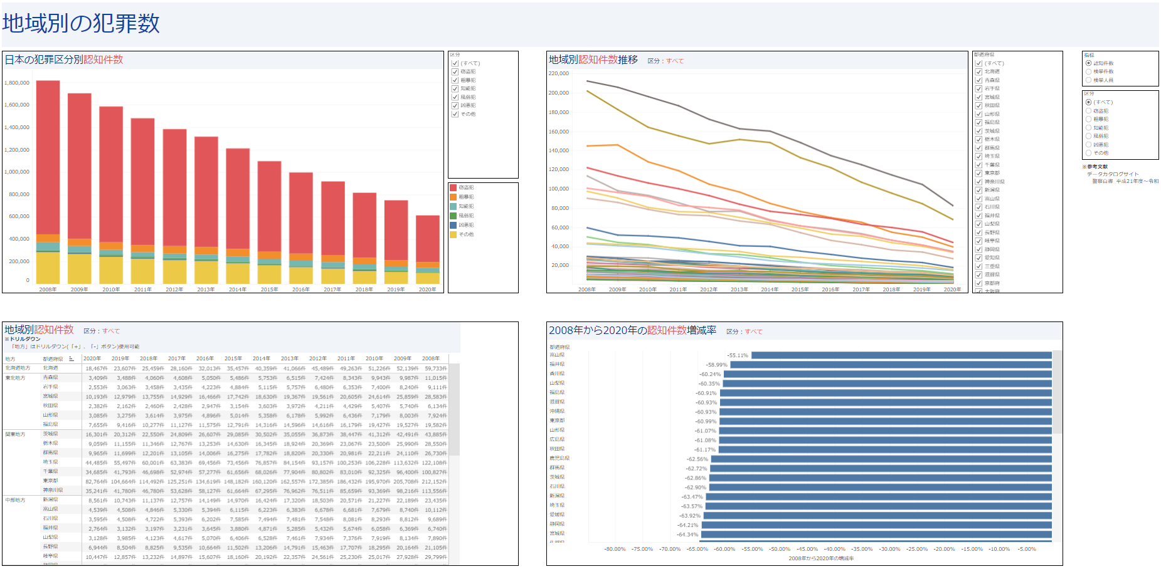
Number of Crimes by Region
Notes:
I shows clear understanding of crime rates all across Japan.
This straightforward information is incredibly helpful for the police and other law enforcement agencies, as it allows them to plan and execute strategies to prevent crime more effectively.
On the other hand, this information is also useful for ordinary people, as it keeps them aware of the safety situation in their local neighborhoods.

Slide 11
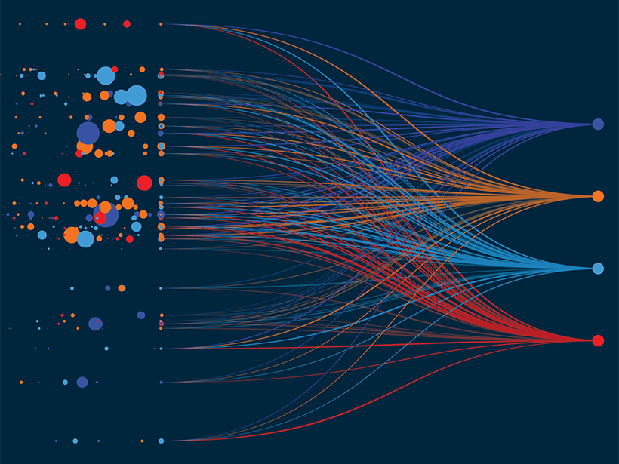
Open Data and Machine Learning
Notes:
Open data also plays a critical role in fields like machine learning,
When there’re more data available, scienticts and businesses can learn ML models easier.

Slide 12
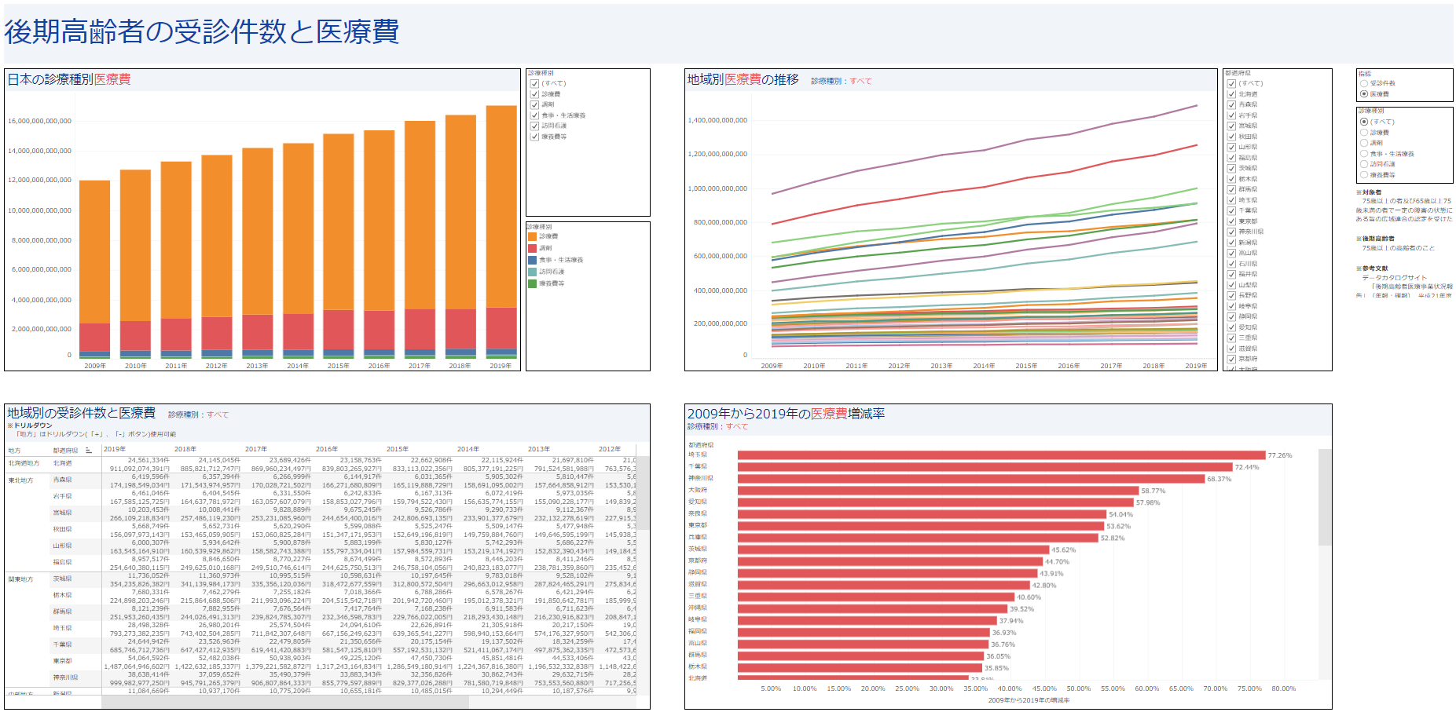
Number of Medical Examinations and Medical Expenses for Late-stage Elderly
Notes:
gives a good intuition about the aging of Japanese folks. By the use of these insights it would be possible for them to make clearer decisions on their health-care system.
Here is a good point to mention Germany and it’s problem regarding aging(demografischer Wandel).
If Germany would publish the collected data, it could lead to these nice graphs and new intutions through the socity, and as a result help the health care system, especially when it comes to older people.

Slide 13
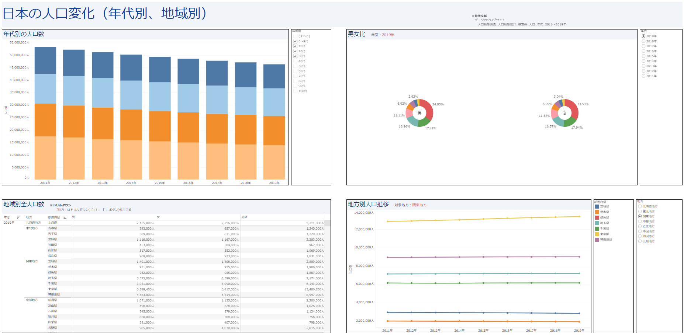
Population Change in Japan
Notes:
This gives us information change of different age groups in each region
This data is really useful because it can help with a lot of important decisions.
guide the planning of cities and towns
plan things like new roads or buildings
guide education programs
shape government policies

Slide 14
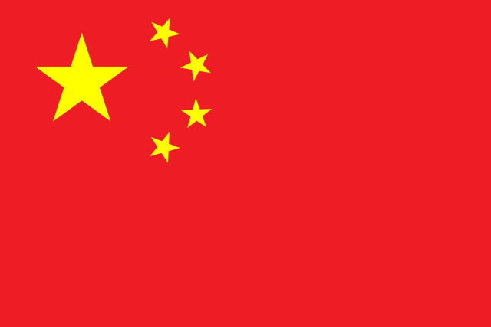
Economical Advantages of Open-Source in China
Notes:
I wanna explore an open-source project in car industry and realte it to car industry of Germany

Slide 15
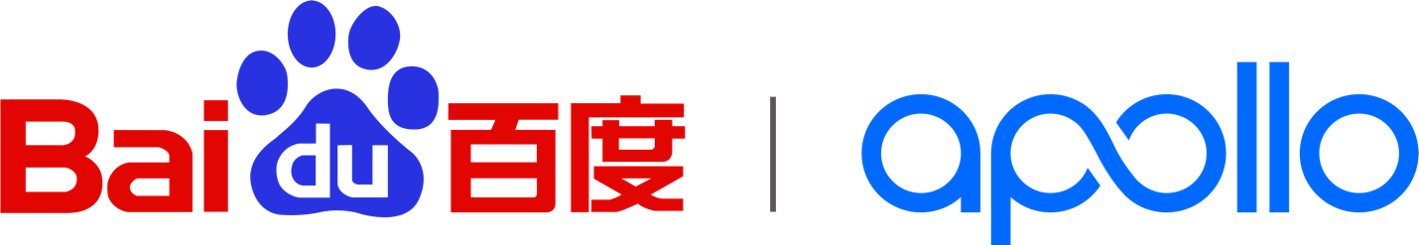
Introduce Apollo Project
Notes:
This project comes from China and was started by Baidu, a big name in internet and AI.
Started at 2013 and launched Apollo in 2017
a leader in three important areas - self-driving cars, smart cars, and intelligent transportation
They’ve predicted by next year they’ll run their products in 30 cities with 3k self-driving cars for 30m users
community of 80k developers helping to make the project better.
There's also a lot of open-source code - over 700k lines!

Slide 16
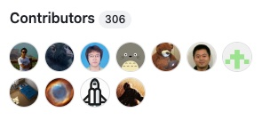
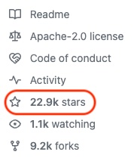
On GitHub

Slide 17


Benefits of Open-source approach for Baidu
Notes:
By an open-source approach, Apollo could grow quickly and affordably less than 4 years.
Let's look at how this worked.
anyone can contribute their ideas and skills
has a huge community of 80K developers from all over the world
mean Apollo can develop new features and fix issues much faster than they could alone
It's like having an enormous team but without the usual cost.
If a user spots a problem or has a new idea, they don't have to wait for Apollo to take action - they can make changes themselves.
This keeps Apollo agile, able to adapt quickly to user needs and new trends.

Slide 18
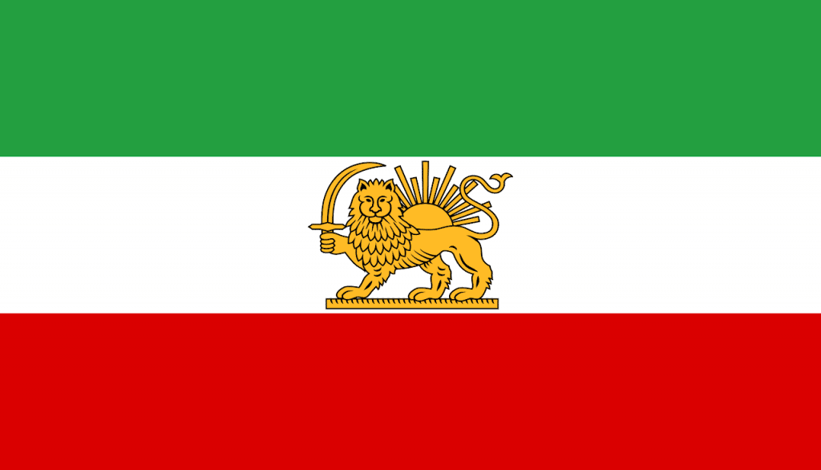
Cultural Impact of Open-source in Iran

Slide 19
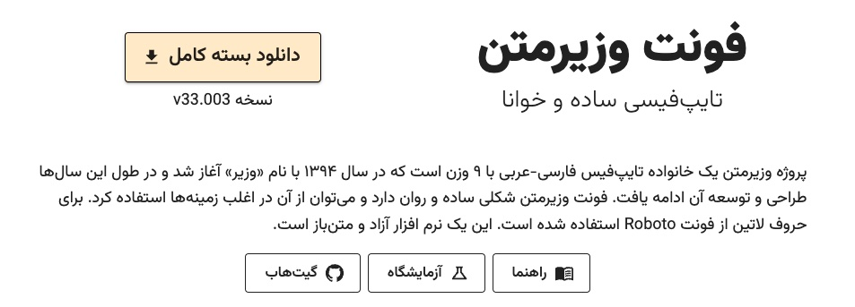
Vazirmatn Font
Notes:
Let's shift gears a bit and talk about a different kind of open-source project, the Vazirmatn Font.
This is a popular Persian font used in Iran and it started in 2015 as part of the Vazir project.
The goal was to create a clear, easy-to-read font for the web and apps, mainly for Persian speakers.
They designed Vazirmatn using an open-source tool called Fontforge,
and they even integrated it with the Roboto font for Latin characters.

Slide 20
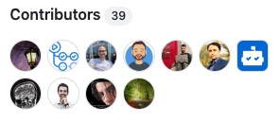
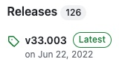
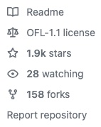
Vazirmatn's Popularity
Notes:
The font has been very successful, with over 2K stars
an impressive 158 forks on GitHub
It's had contributions from 39 different people and has had 126 releases
That's a lot of people using and improving this font!

Slide 21
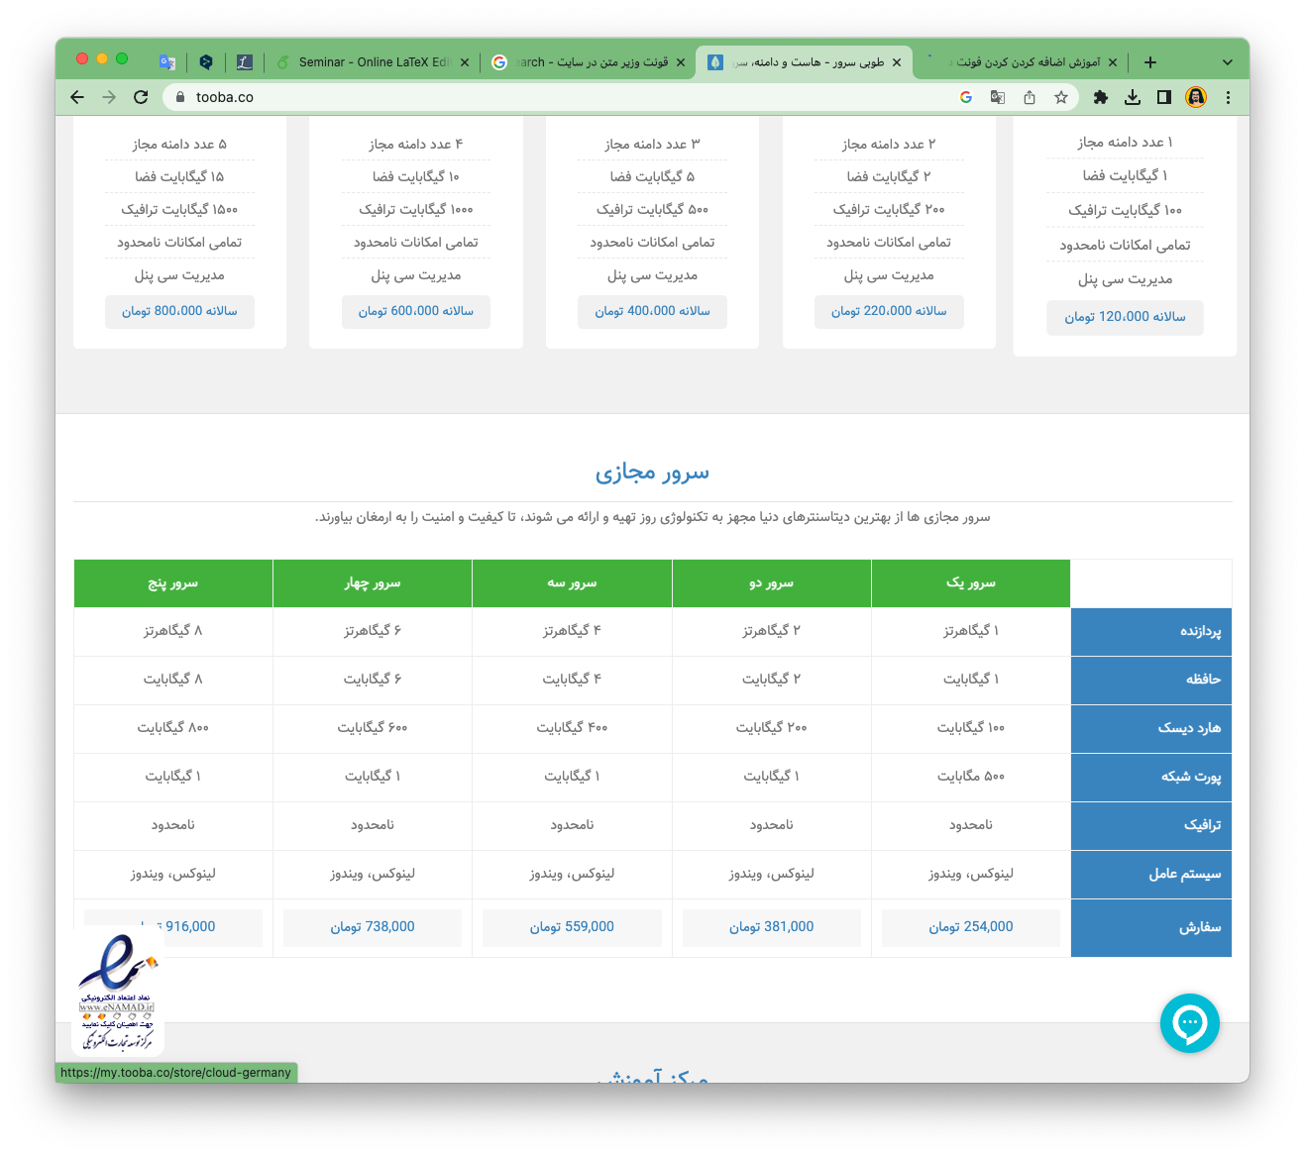


Vazirmatn's Impact on Society
Notes:
And it's not just popular on GitHub. Vazirmatn is used all over Iran - on websites, in apps, and even in book publishing.
It's improved feel of visual communication in the country.
This has helped to raise the standard of design and contributes to a stronger cultural identity.
So you see, open-source isn't just about technology. It can also make a big impact on culture and daily life, just like the Vazirmatn Font has done in Iran.

Slide 22
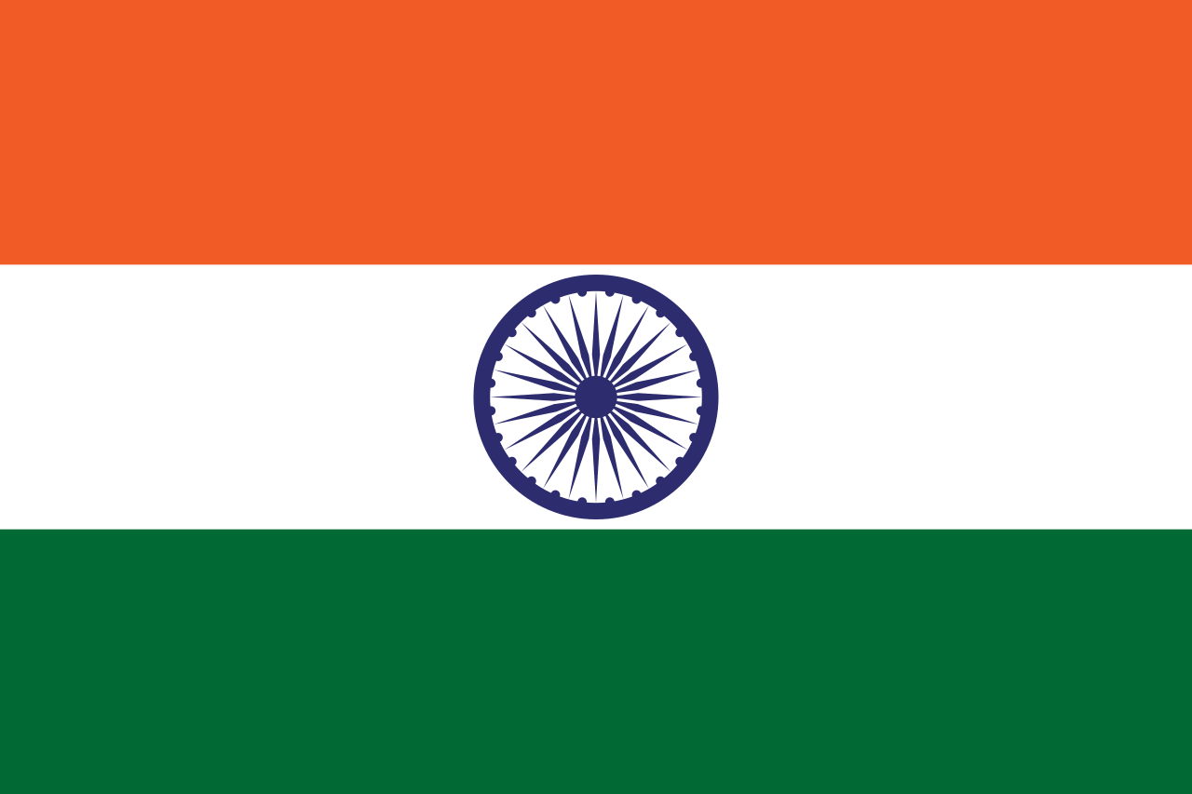
Digital Sovereignty in India
Notes:
Let's talk about how India is taking control of its digital future.
You may know that big tech companies have a lot of influence these days, so many countries are working on what we call 'digital sovereignty'. This means they want to control their digital data and services. India is one of these countries.

Slide 23
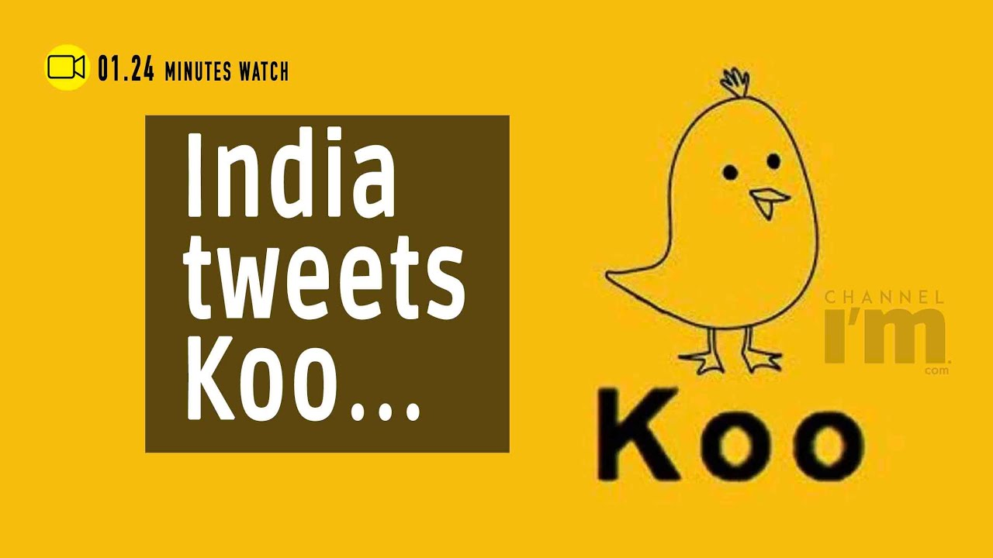
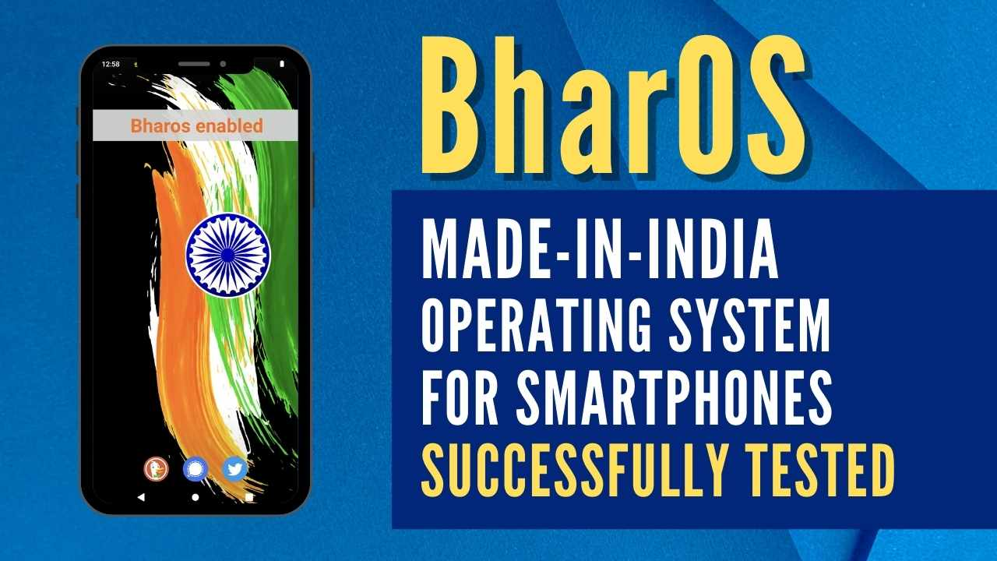
Rising Indian Tech Solutions
Notes:
India has made a significant move towards digital sovereignty by developing two key applications.
This initiative has been taken to prevent the transfer of user data to foreign entities.
India is creating its own tech solutions, like Koo and BharOS. These tools are not only popular in India, but they're also gaining recognition globally.

Slide 24
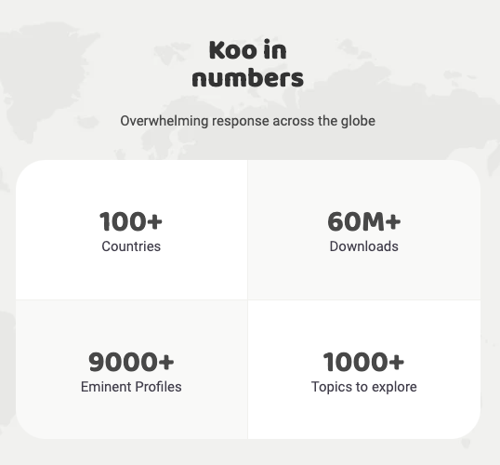

Koo
Notes:
A good example is Koo, which is a platform like Twitter, but it's made in India and focuses on Indian languages.
It's an app that serves over 60M users across more than 100 countries worldwide.
The platform offers over 9K profiles to connect with and explore, spanning across over a thousand diverse topics

Slide 25
BharOS
Notes:
BharOS is a mobile OS developed in India with a focus on digital sovereignty.
It's a locally built solution that offers an alternative to widely used platforms like Android.
The system places a strong emphasis on user privacy and security.
It does not come with pre-installed apps or services, giving users the power to control permissions and data access.
The BharOS project showcases how locally developed technologies can be leveraged for a more self-reliant and secure digital future.

Slide 26
Conclusion
Asia | Germany 🇩🇪
🇯🇵 Japan open-data and elderly insight | Common challenge
🇨🇳 Apollo | Faster adaptibility of car industry
🇮🇷 Vazirmatin font | Duden
🇮🇳 Digital Sovereignty | Alternative products
Notes:
It’s time for conclusion and taking lessons from the examples that I’ve presented for Germany

Slide 27

Policy and Governmental Level – Japan’s Open-data and aging challenge 🇯🇵🇩🇪
Notes:
let's talk about a common challenge that both Germany and Japan face - an aging population.
Majority of people are getting older, and we need to think about caregiving and retirement.
Imagine if we had access to a much of data about aging from the government, data that can be freely used by anyone.
This is what Japan has done with their open-data approach.
What could we do with such data?
it could inspire our community of volunteer developers, researchers and businesses to dive deep into the data and find new ways to tackle the aging issue.
They could create new solutions, new services, and new ideas to help us all.
It could be a game-changer in managing the aging challenge.

Slide 28
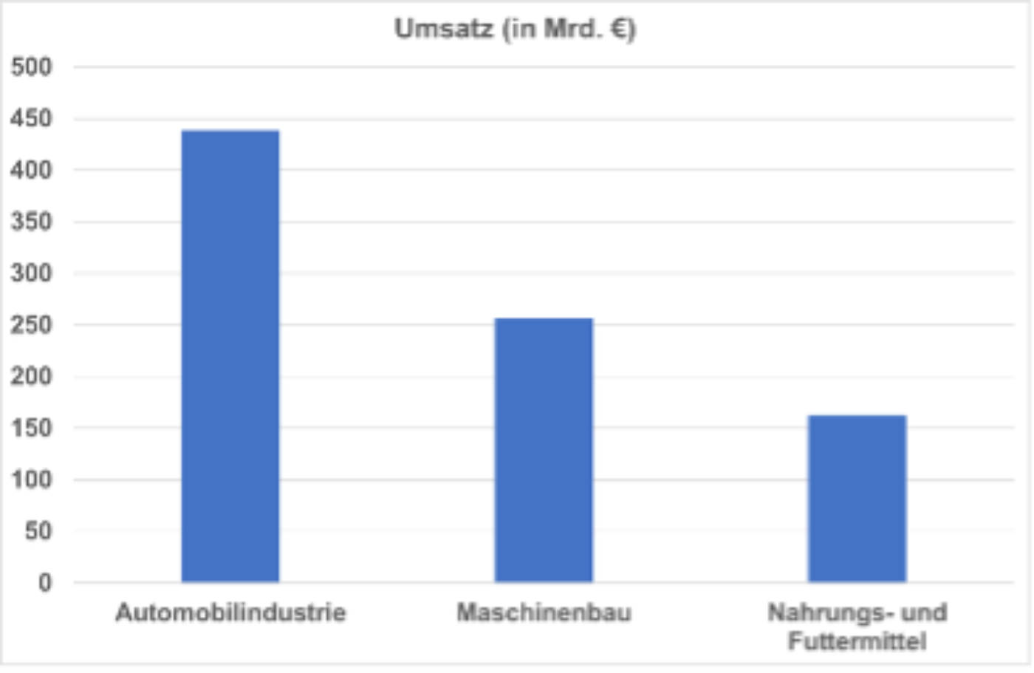
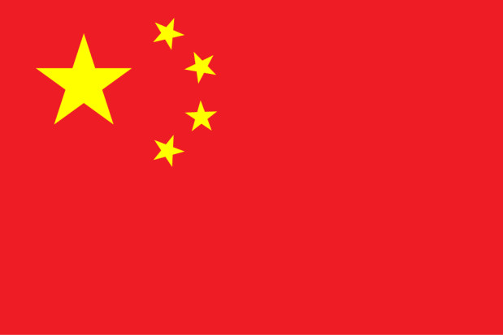
Economic Growth – China’s Apollo and German Car Industry 🇨🇳🇩🇪
from vda.de at 2019
Notes:
The car industry is the backbone of Germany's economy. It makes a lot of money for the country. In 2019, it made €438.8 billion. This is more than any other industry in Germany. So, we need to pay a lot of attention to the car industry. It can help Germany's economy a lot in the future.
In China, the Apollo project has shown how using open-source can lead to big successes.
This project has grown fast and has big plans for the future.
What can we in Germany learn from this?
The car industry is vital for Germany.
But soon, In Germany we can't sell petrol and diesel cars anymore.
So, we need to move quickly to make electric cars.
Apollo can teach us how to do this.

Slide 29
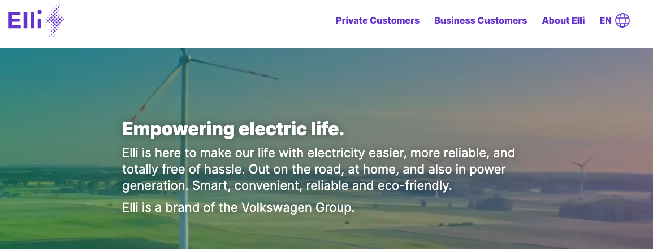

Elli as an Example
Notes:
let's take a look at an exciting example - Elli. Elli is a special group from Volkswagen, and they are focusing on Electric and Autonomous cars, very much like what Apollo is doing in China.
Just like Apollo, Elli can benefit greatly from an open-source approach. By doing this, Volkswagen can adapt more easily to the market, especially given the upcoming ban on petrol cars. With open-source, costs can be lowered and improvements can be made faster.
Now, imagine if all the German auto companies decided to follow this approach, just like Apollo.
This could really help Germany as a whole to remain competitive in the car industry.
We can continue to be a top player in the global car market.
This way, we can ensure the future success of Germany's automobile industry.

Slide 30
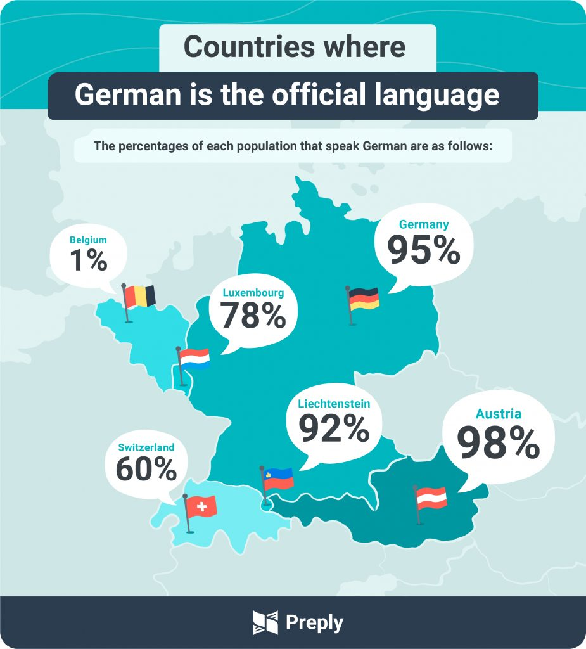

Cultural Influence – Iran and Vazirmatn Font 🇮🇷🇩🇪
Notes:
Now, let's talk about how open source can impact our culture.
A great example is from Iran with the Vazirmatn font. This open-source font has not only improved the quality of life in Iran but also sparked a sense of patriotism among Iranians.
They have come together to collaborate on the development of this font, enriching their culture in the process.
Just as Iran's experience with the Vazirmatn font, we too have an opportunity to enrich our culture. We have the Duden dictionary, the primary reference for the German language.
Like any language, German is dynamic and constantly changing.
By making the Duden dictionary an open-source project, we could engage German speakers from around the globe to contribute to its maintenance and updates.
This not only supports the constant evolution of the German language but also helps to build a strong sense of community among German speakers worldwide, and
it's free of charge! That's a powerful way to enrich our culture.

Slide 31
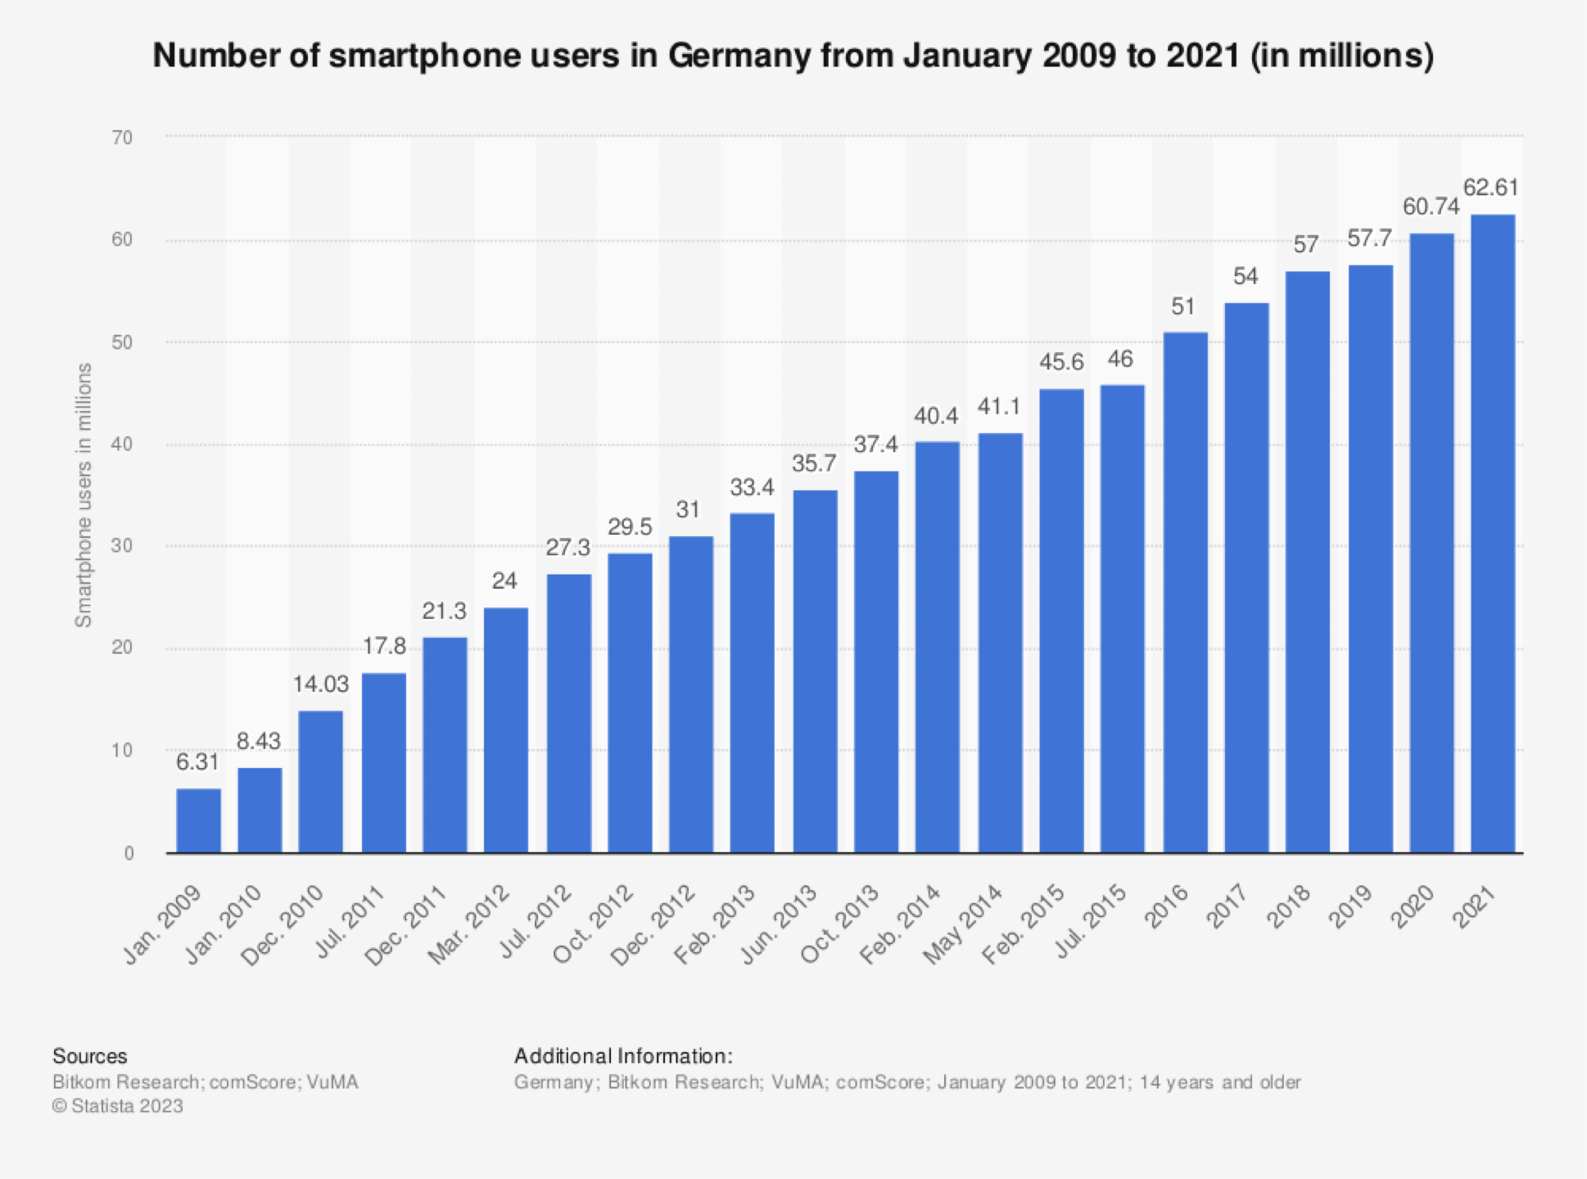

Digital Sovereignty and India 🇮🇳🇩🇪
Notes:
Let's turn our attention now to Digital Sovereignty
India has made significant strides in this regard, developing their own applications like Koo and alternative operating systems like BharOS
These efforts allow India to control and shape their digital environment in a way that best serves their citizens. Not only does this offer better security and privacy, but it also ensures the rights of its citizens.
Just like in India, more and more of our population are relying on mobile devices and the internet for daily activities.
If we follow India's example and develop our own digital ecosystem, we could have more control over our digital world.
This could lead to stronger protection for our digital rights which could be a great benefit for all of us here in Germany.

Slide 32
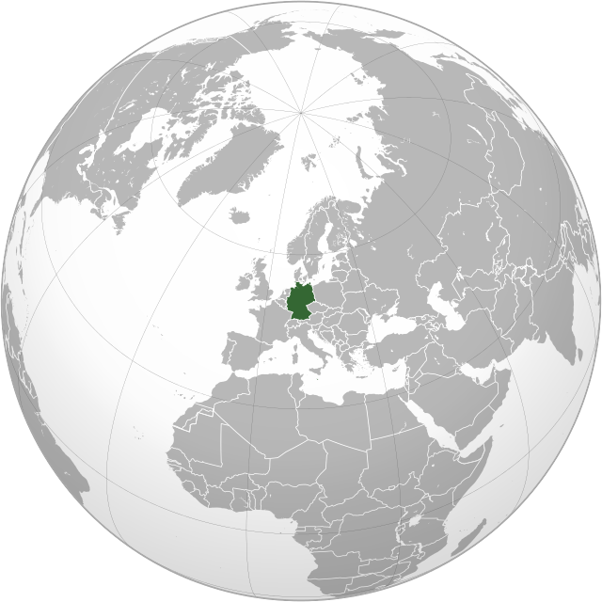
Asia & Germany
Notes:
So, what can we learn from all of this?
The open-source movement is changing the world. We've seen this in Japan, China, Iran, and India.
For us in Germany, the message is clear.
Open-source can help us make progress in technology, economy, and culture.
And by making our own local services like India, it can also help us keep control over our digital world.

Slide 33
Summary
Asia | Germany 🇩🇪
🇯🇵 Japan open-data and elderly insight | New solutions
🇨🇳 Apollo | Faster adaptibility of car industry
🇮🇷 Vazirmatin font | Duden
🇮🇳 Digital Sovereignty | Same approach

Slide 34

Finishing!
It’s is about sharing ideas, trust, and working together.
Notes:
But remember, open source isn't just about sharing code. ‘It’s is about sharing ideas, trust, and working together.’
As Linus Torvalds, master mind and engineer behind Linux kernel

